Slide 1
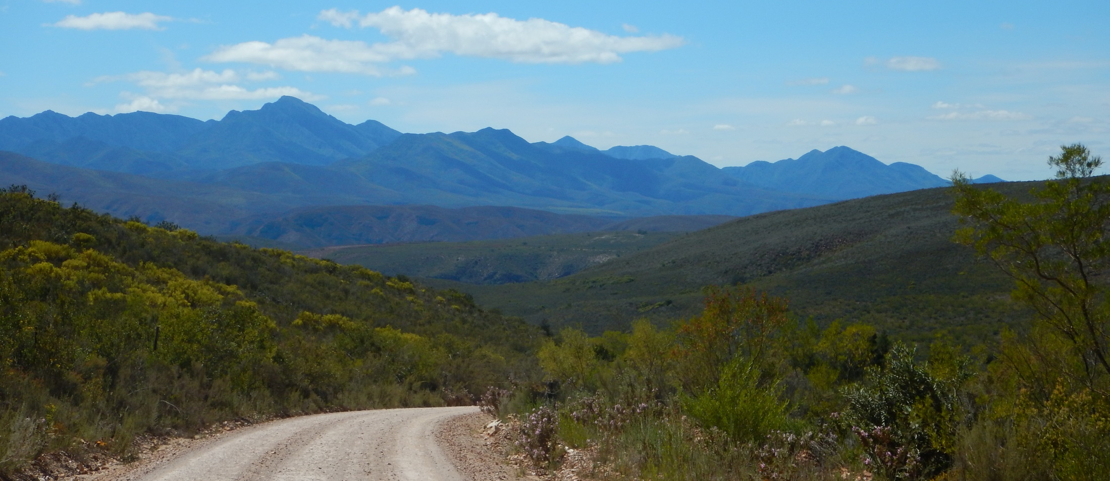
March 2018
Notes:
Welcome

Slide 2
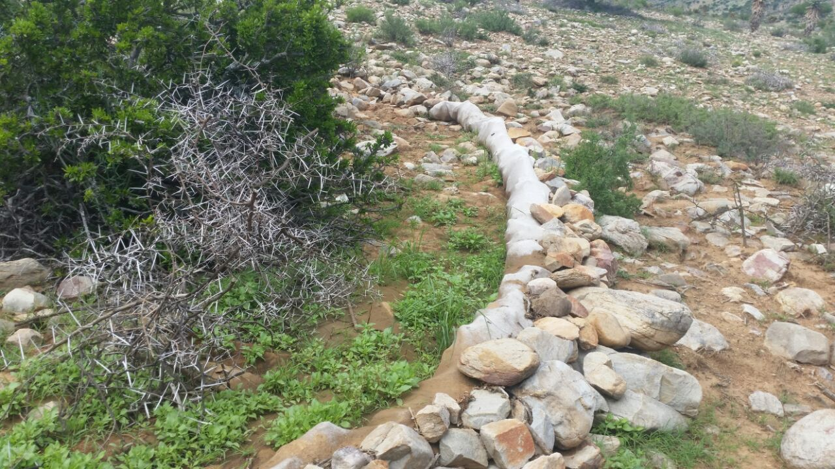
Baviaanskloof: Students and Research
Notes:
Bv differences in recruitments etc

Slide 3
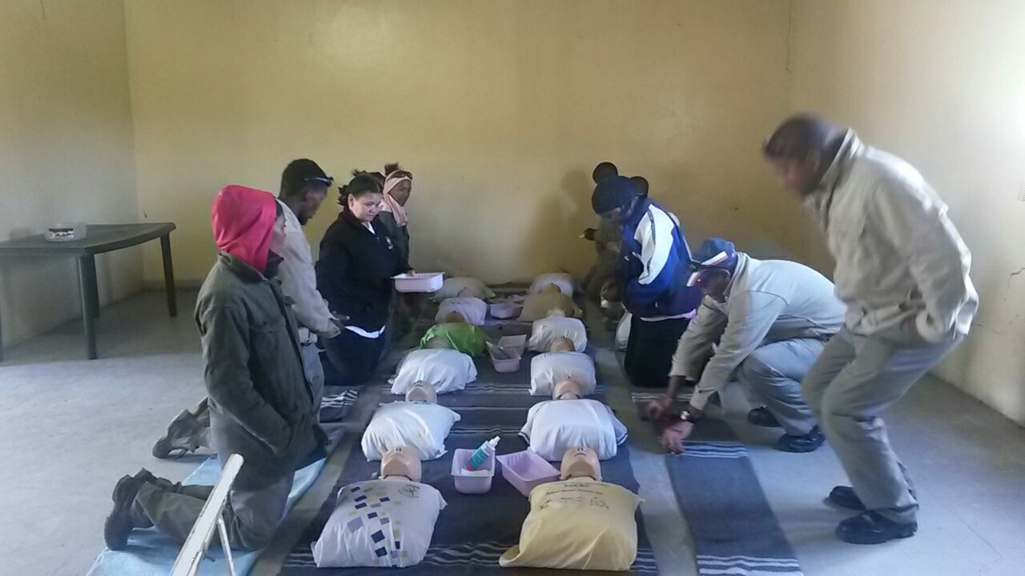
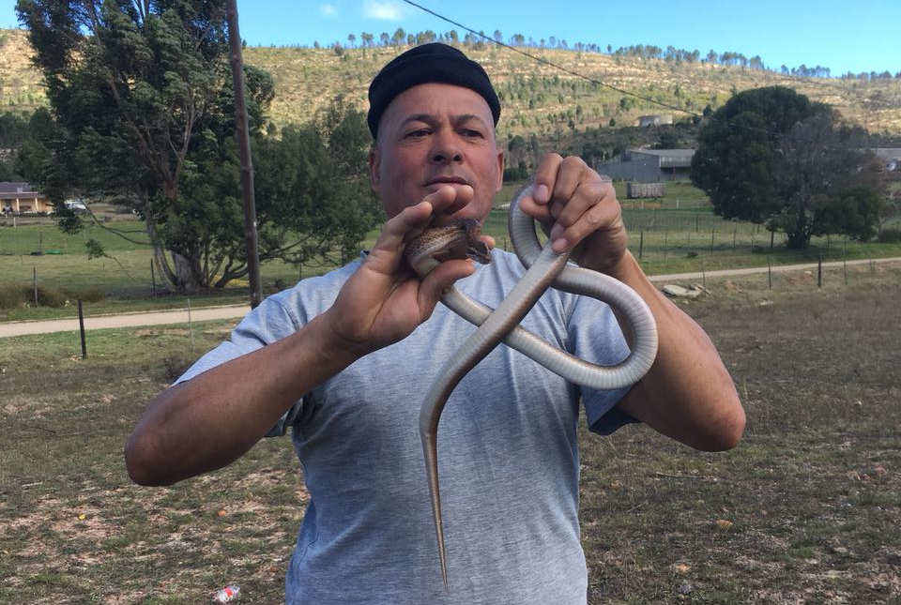
Langkloof: HB Learning Journey, First Aid & snake ID Workshop
Notes:
Snake ID and First Aid for HB harvesters
HB Sensing Journey, some need for a collective – HB Association with 2 groups – wild & cultivated. Are in touch with all the major role players; HBCop, SAHTA, etc.
Resource Aasesments – eventually include AIS management

Slide 4
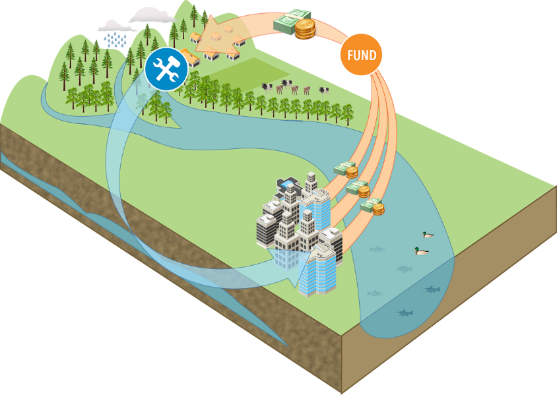
Langkloof: Water Fund
Funding mechanism: collect and provide
Governance mechanism: Joint decision-making
Watershed management mechanism: implementation
Notes:
Linking upstream and downstream, Platform that can serve as a funding mechanism for upstream intervention

Slide 5
Langkloof: Water Fund
Steering Committee: Strategic, long term planning and resource allocation (1 meeting)
Working Group: technical expertise guiding practical implementation in catchment (2 meetings)
Notes:
Linking upstream and downstream, Platform that can serve as a funding mechanism for upstream intervention
Dovetail with Algoa Recon; by bringing the upstream and downstream together; add to the meeting and feedback, help to achieve their goals, support the Algoa meeting
Commited – NMBMunicipality, Water Affairs (Paul Chilton), NRM Japie, GIB,
Coca Cola, GIZ, Santam LL, Patrick King, TNC
Working Group – Woodlands Dairy, Greater Kromme Stuartship, ECPTA, Environ Affairs, SAEON
We facilitate but steering committee runs with it
Restoration, conservation, regenerative Agric

Slide 6
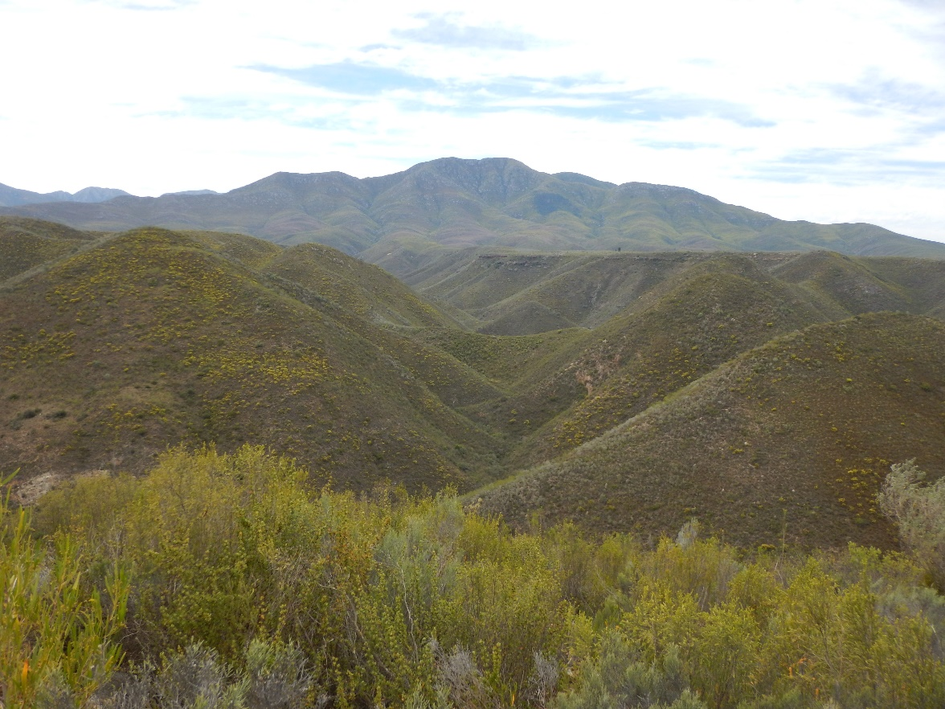
Thank You

